Slide 1
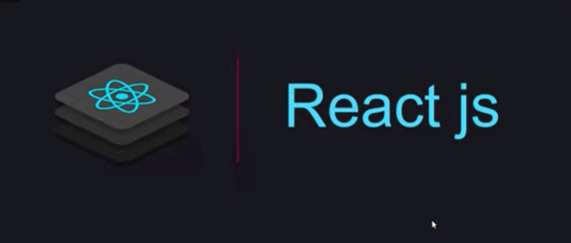
React Js
FACEBOOK

Slide 2
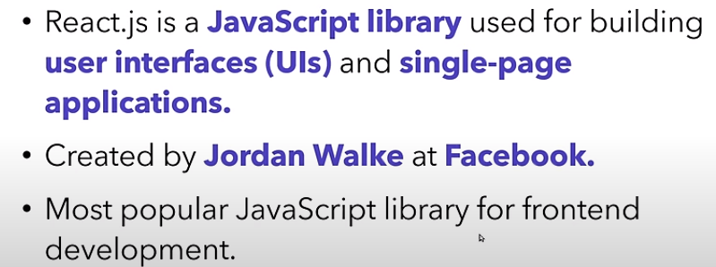
Introducation to React JS

Slide 3
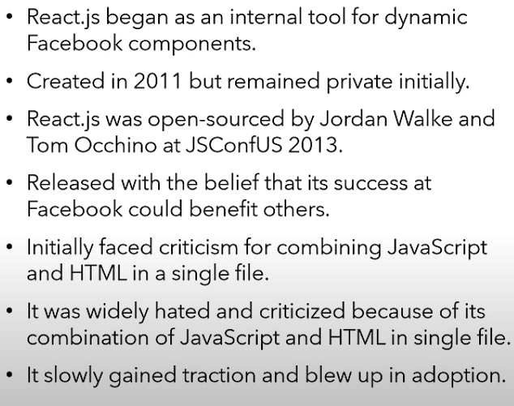

Slide 4
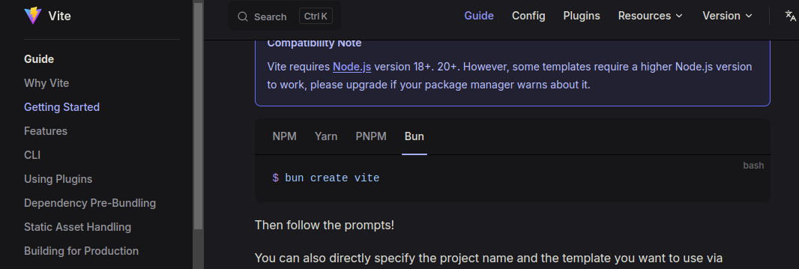
React Js INstall (npm i -g bun) (bun i vite) bun dev bun i react@rc , bun i react-dom@rc

Slide 5
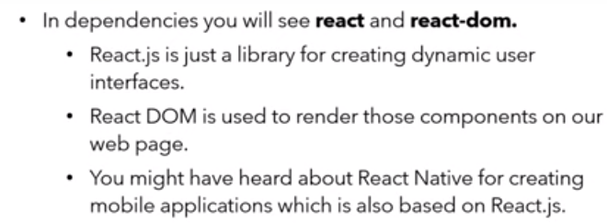
React and React-dom

Slide 6
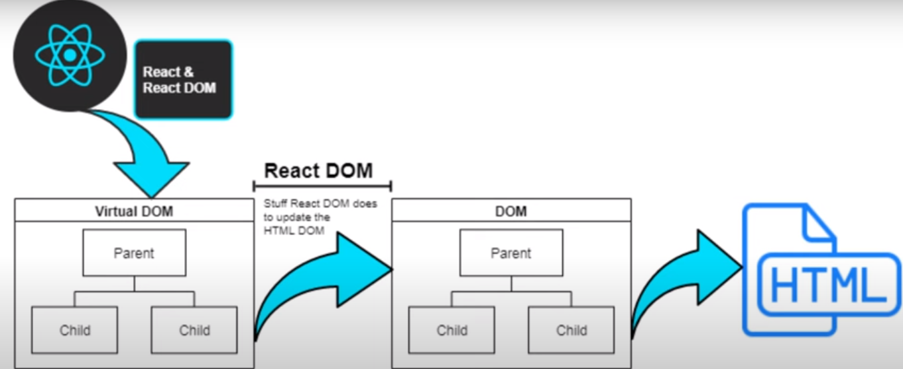

Slide 7
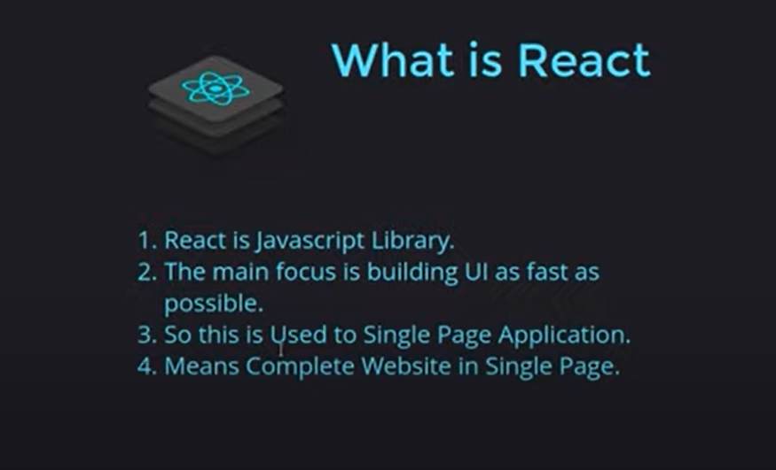

Slide 8
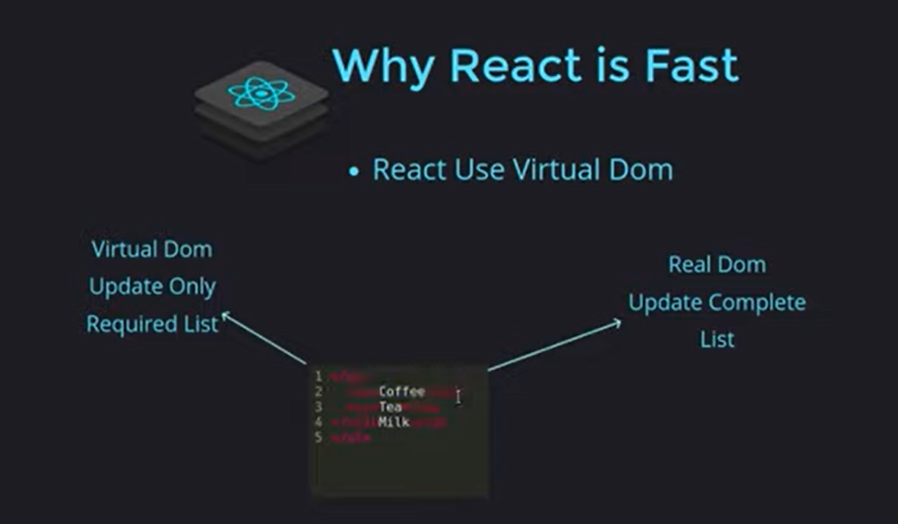

Slide 9
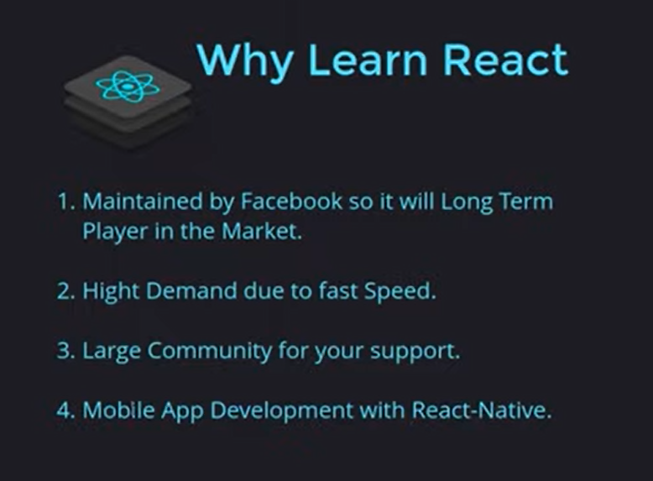

Slide 10
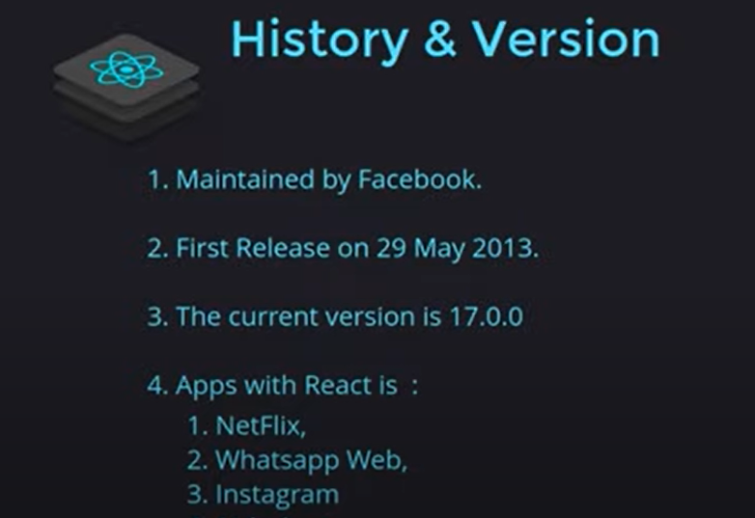

Slide 11
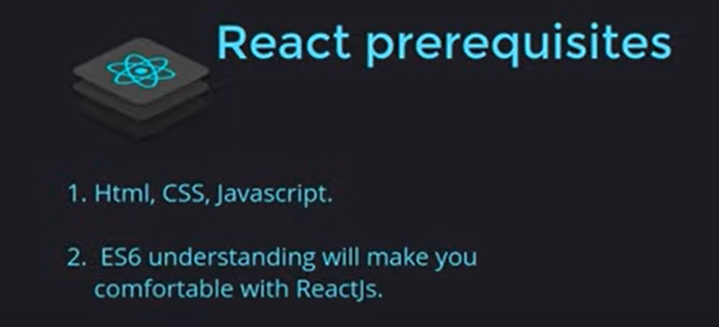

Slide 12
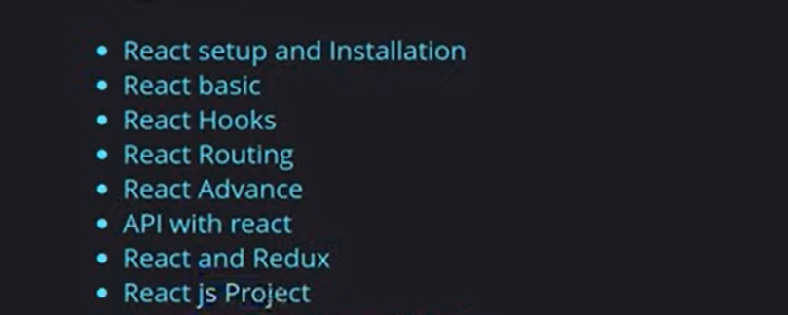
REACT TOPIC

Slide 13
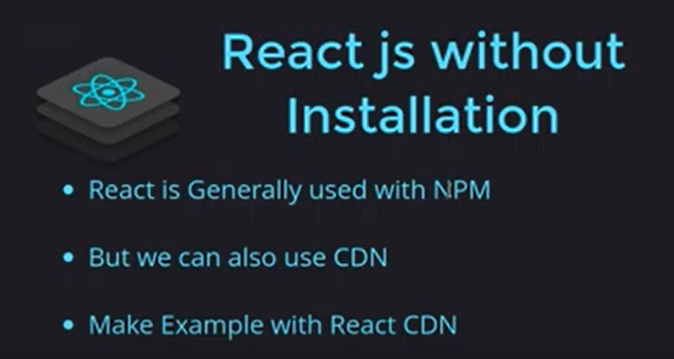

Slide 14
React Install (Node Package Executor)
node js
NPM install
npx create-react-app my-app
npm create vite
cd my-app
npm start

Slide 15
ES6 javascript part
let ,const
arrow function
export and import (Modules) es6
oops
inheritance
es7 ke kuch part
spread and rest operator
destructuring(array or object)
Reference and primitive type
map,filter

Slide 16
Node js
javascript ka code jo hum browser par run karate hai ushe javascript kahatehai.
javascript ka bo code jo jo ap bana browser ke run kar sakate ho ushe node js bolte hai.
pahale javascript bana tha browser mai run karnane ke liye.fhir logo ne kya kiya jo chrome mai jo javascript engine hota .jo javascript ko run karta hai browser par ushe engine ko V8 name rakha gaya bolte hai.
logo ne kya kiya jo javascript engin jo v8 h ,ushe bahar nikal diya or PC mai direct run hone ke layak bana diya...
pahele javascript browser par run hota tha.par ap bo ap ke pc mai run hone laga ...ex,, c ,c+,java

Slide 17
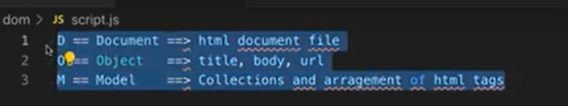
What is DOM? | DOM vs Virtual DOM

Slide 18
React Developer Tools install
React Developer Tools
ES7 React/Redux/GraphQL/React-Native snippets (vscode mai)
Bracket Pair Colorizer
Auto Rename Tag
live server
Prettier - Code formatter

Slide 19
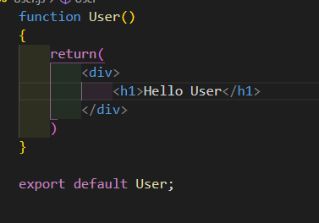
Functional Component
User.js

Slide 20
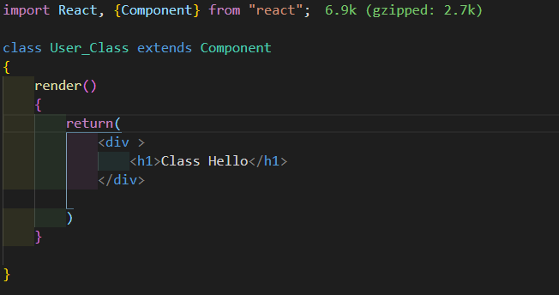
Class Component
User_Class.js

Slide 21
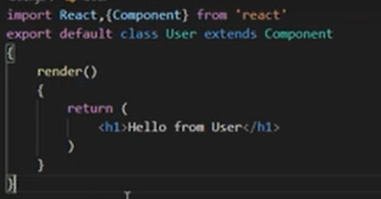
Class Components

Slide 22
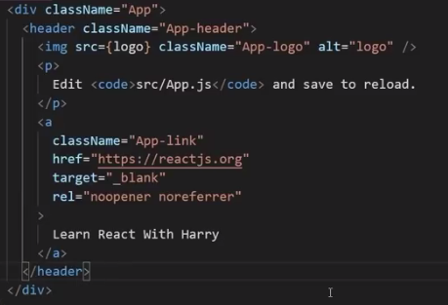
Introducing JSX (class->className,) use (emmet) javascript - >javascriptreact div.black class ek reserved keyword hai

Slide 23
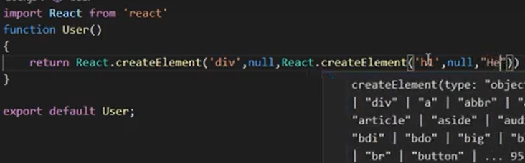
REACT JSX WebPack ----BABEL

Slide 24
WebPack --BABEL
WebPack ---
jab react ko install karete hai to sath mai webpack or Babel install ho jate hai
react ke andar jo bhi hum banate hai ush ek bandal ke form mai rakhta hai
ye webpack ka kam hota hai
Babel--
ES6 ke code ko browser nahi samajhta
moden javascript ke code ko browswe nahi samajhta
babael es6 ke code ko convert karta hai

Slide 25
React-Dom(Manipulating documents)
javascript file se html file mai kuch change karta hota hai.
kuch add karna hota hai ushe dom manipulating kahate hai.
ReactDom ko kiyo import karte hai taki dom manipulating kar sake

Slide 26
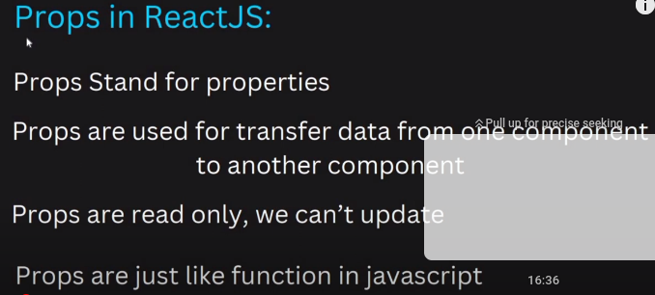
Props In React js

Slide 27
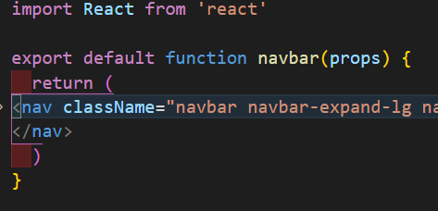
Props with functional component
components -> Navbar.js
rfs (import shot trick)
import React from 'react' (navbar.js) components
.Props in class component

Slide 28
Props (property)
<Navbar title = "PNINFOSYS" aboutText ="About Us"/>
function Welcome(props) {
return(
<h1>Hello, {props.name}</h1>;
)
}

Slide 29
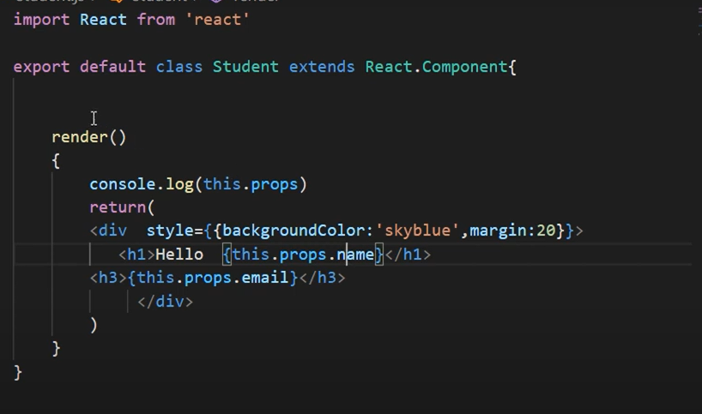
Class Props

Slide 30
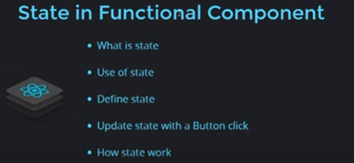
State in Functional
varibale update nahi hote component mai.
state basical ek object hota hai.jese variable mai data store karate hai .
ushi taraha object mai bhi data store karate hai.....
state ok update kar skate hai..
varibale ko nahi..
compont ko pata chal jata hai kuch n kuch update hua hai. state ke andar or ushe print kar deta hai.

Slide 31
State with functional component
state ek obaject hota hai.jese varbale mai andar mai data store karate hai.base hi..
state mai data store karate hai.
State with class component

Slide 32
React Router v6
npm install react-router-dom
https://reactrouter.com/docs/en/v6/getting-started/installation#basic-installation

Slide 33
use SearchParams and setSearchParmas

Slide 34
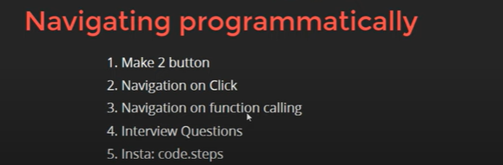
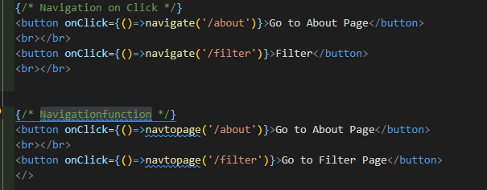
Navigation on Click | Navigating programmatically
Home .js

Slide 35
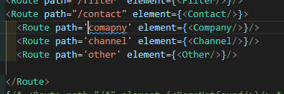
Nested Routing

Slide 36
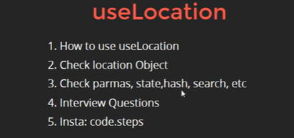
useLocation Hooks
user Location sara data de deta hai
data pas kese ho raha hai.change kar paye.

Slide 37
Protected Route

Slide 38
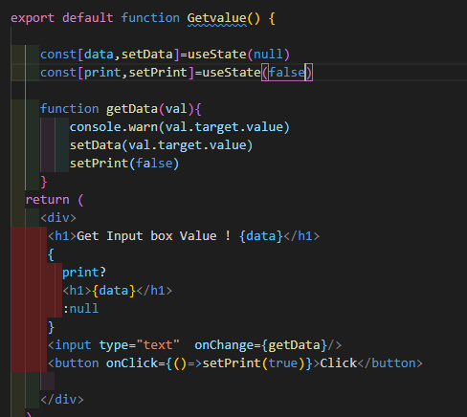
Get Input box value(video dekhna hai)

Slide 39
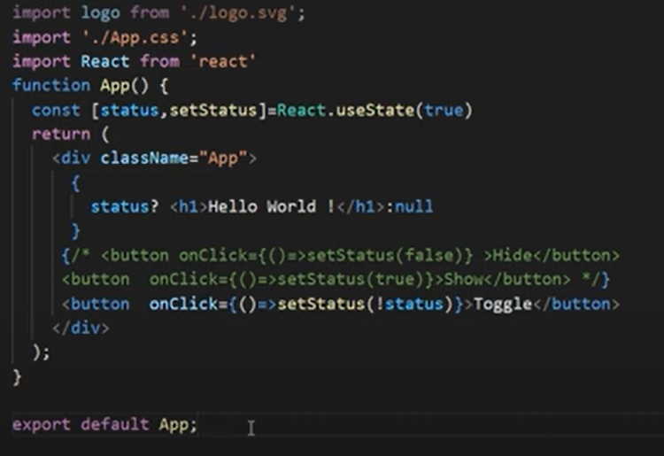
Hide , Show and Toggle in element ya Tag

Slide 40
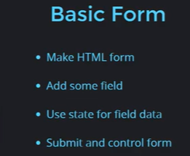
Handle Form | checkbox | input field | select

Slide 41
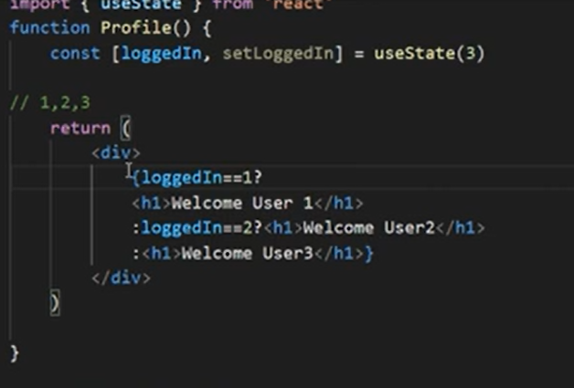
Conditional rendering | If Condition(profile.js)
profile.js

Slide 42
Basic Form validation

Slide 43
Pass Function as Props
parent to child
user.js

Slide 44
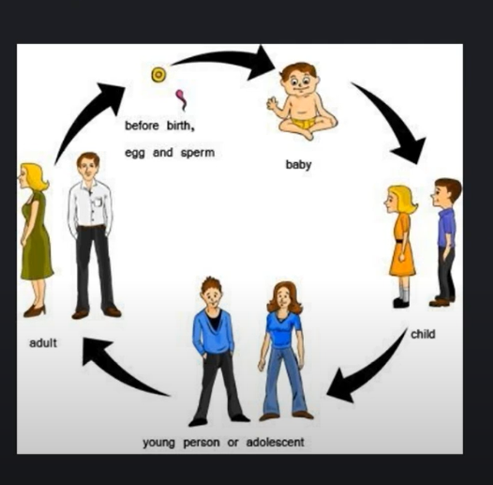
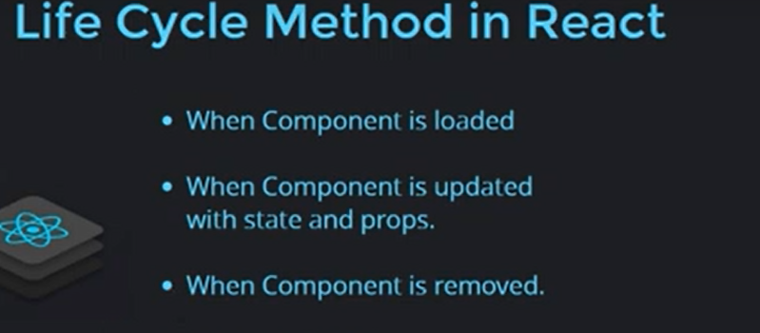
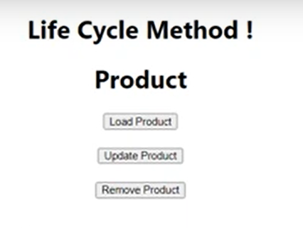
What is life cycle method
fhesh 3 hote hai
pahala
birth,update,deth hona

Slide 45
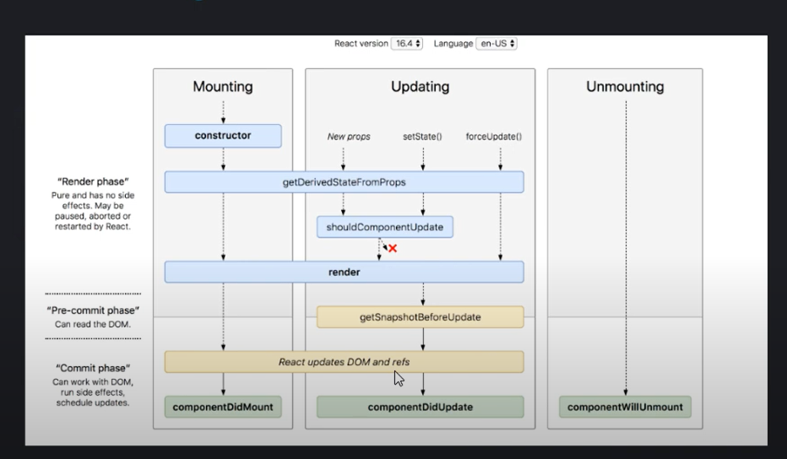

Slide 46
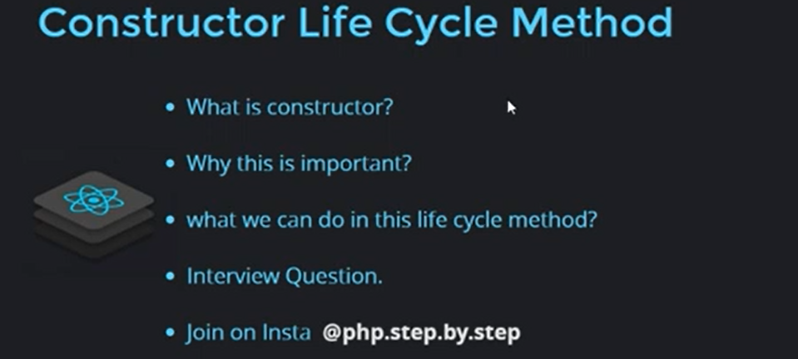

Slide 47
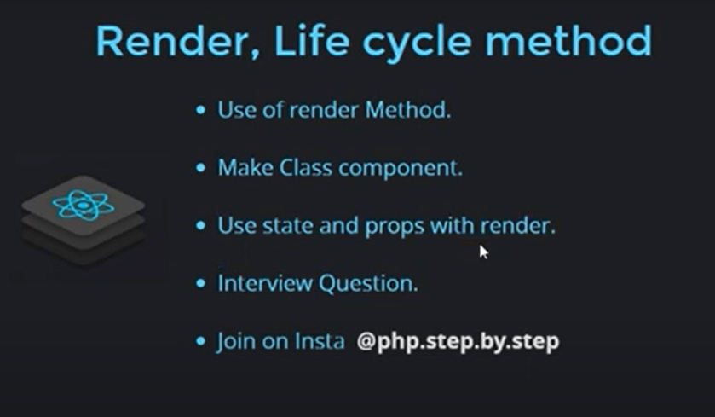
Render method har bar update hota hai.. render1.js

Slide 48
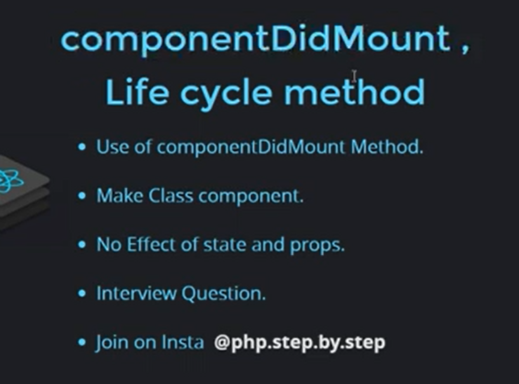
CompnentDidMount(api ke liye)
sab se pahale load
1.constructor
2.render
render ke bad banta hai
3.compnentDidMount
mount(html css sab kuch ready ho chuka hai..)ush ke bad call hoga

Slide 49
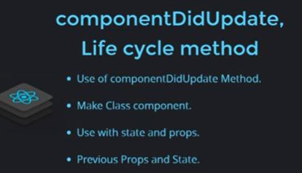
ComponentDidUpdate

Slide 50
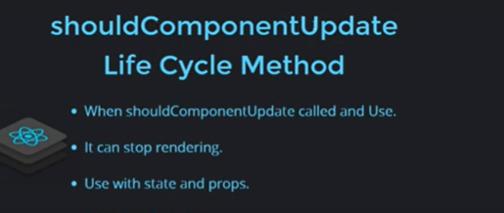
shouldComponentUpdate life cycle method

Slide 51
componentWillUnmount life cycle method

Slide 52
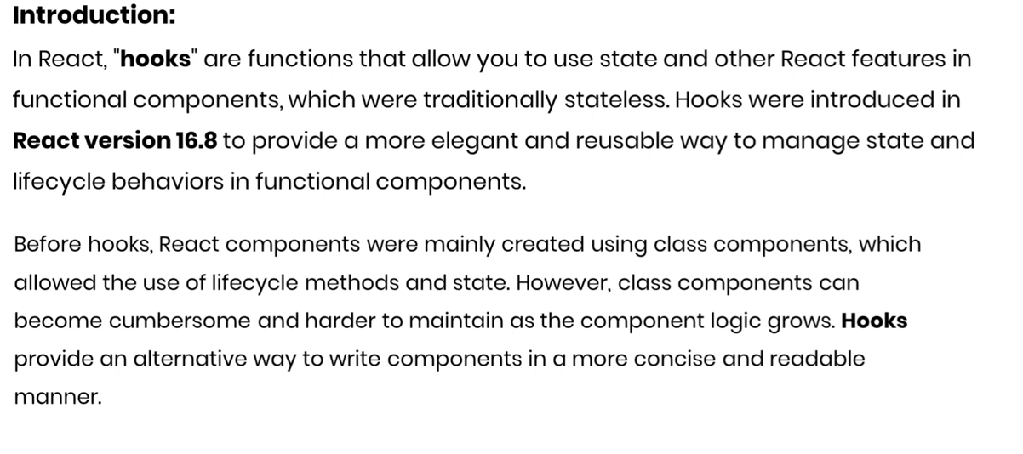
React Hooks Lifecycle Method

Slide 53
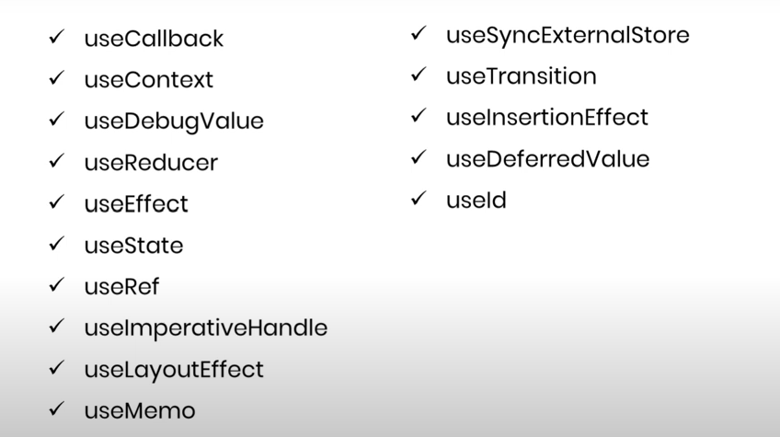

Slide 54
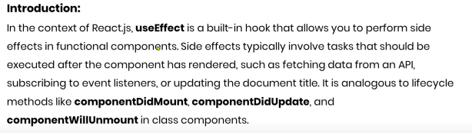
UseEffect

Slide 55
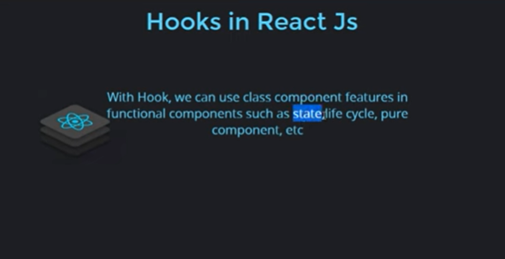
Hooks in ReactJs

Slide 56
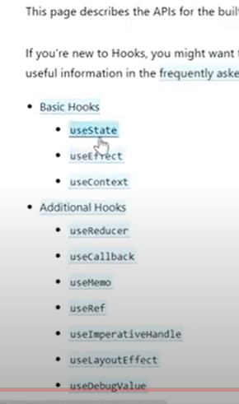
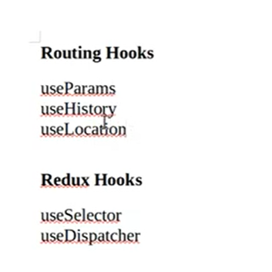

Slide 57
UseState
is ko hum kisi if ,for ya function mai nahi rakh skate hai..

Slide 58
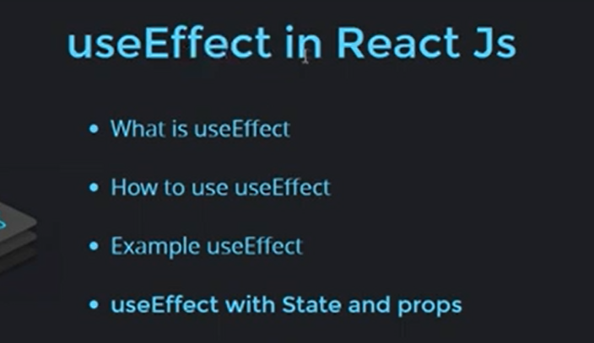
UseEffect

Slide 59
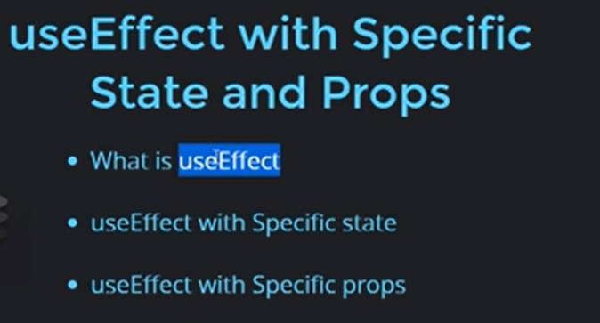

Slide 60
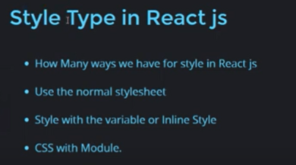
style in ReactJs

Slide 61
Insatll Bootstrap
https://react-bootstrap.github.io/components/buttons/

Slide 62
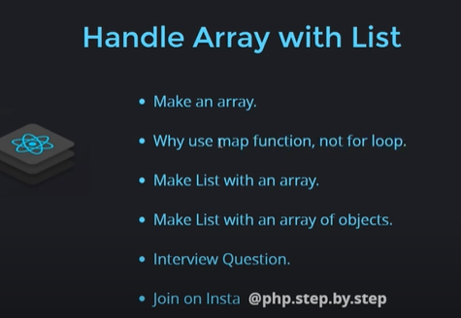
Handle Array with List map function

Slide 63

List with Bootstrap Table

Slide 64
Nested List in ReactJs

Slide 65
Reuse component in loop

Slide 66
Send Data Child to Parent Component

Slide 67
Pure component (rendering rokta hai)

Slide 68

useMemo Hook

Slide 69

useContext Hook

Slide 70


Slide 71
Ref with Example
react js khud bta hai ref ko kam use karo.react js bolta hai ap DOM ko maipulate mat karo,
Dom ko mainipulate karoge to react js show ho jaygei,
state props ke sath work karo..
ref ke pass power hai kisi ko hide show karne ki..
dom ko mainipulate kar sakta hai.
ref ko use tab karo jab bahut jarurur ho

Slide 72
useRef Hook && forwardRef

Slide 73

React Controlled Component

Slide 74


Slide 75
Uncontrolled Component

Slide 76
Higher Order Component

Slide 77
UseCallback Hook?
useeffect life cyle ke method ke accoding chalta hai..
usememo value renter karta hai ap ko..
usecall back function return karta hai.or ye har bara new value create nahi karta.agar jab tak koyi value change n ho koyi chig.
use callback hook react is used to optimize the performance of your components by memoizing function,
usememo or usecallback kaha use karan chahiye...
jab kabhi ap ko value renter chahiye to ap usememo use kar lege.
usecallback ap ka function ke case mai hoga.childer ke andar ap ne function pass kar rakhe hai as ya props..is is case mai ap callback use kare.
taki react ki perforamce incress ho jayegi

Slide 78


React redux

Slide 79
Redux ek container hota hai jis ke andar hum data store kar skate ho..
ek bahut badha Array jaha par ap ki application ka pura ka pura data store rahata hai...
ex:ghar ka store room baha par ap kuch bhi store kar lo..jab jarurta ho to baha se la skate hao..
ushi taraha redux ek conatainer hota hai ap pura ka pura data baha store rakh skate hai.....
State Management tool kahate hai..
application ki state ko manage karata haii.data a gaya chala gaya ye manage karta hai...

Slide 80
useeffcet vs callback
useeffect ko hum bata sakate hai kab rerender karna hai lifecyele
usecall ko agar lagega ki bahut jada change aya hai.tabhi ja ke bo rerenderkarega.

Slide 81
useReducer

Slide 82

useContext (create,provider,usecontext)

Slide 83


Slide 84


Slide 85


Slide 86

Redux architecture
textForm.js

Slide 87
redux install
npm i redux
npm i react-redux
ye commintion karati hai
react or redux ke beech

Slide 88
Props revision
jab ap redux use karate ho to ap ka sara data props ke through flow hota hai...
ek component se dusare componet ka commision karna ke liye...props ka use karate hai

Slide 89
filer folder structure (Redux)
component
containers
service- (redux rakhege)
actions
reducers
file(index,(root reducers)
constants
containers (component or redux)
connect(map) karega
constants:(actions or reduers dono file lo ko batayega)
actions se data jab reduers mai jayega to kon se data kon se functions mai jayega
action ke anadra or reduers ke andar kayi sare function ho sakate hai...
root reducers kya karega jitne bhi reducers hoge bo ek file mai come bayin kar dega..

Slide 90

jab hum redux use karege to component ko containers ke sath use karate hai..
base hai ye bhi component hi ,..
ane bale time mai hum compont or redux ko map karege......
map ke 2 function hote hai..
use mapDispatchToProps
useMapStateToProps

Slide 91


Add to cart Design (containers )

Slide 92


Action
action react se data send karta hai.. store ke andar
constants :mai hum action ki file rakh rahe hai..kiyoki ush file ko reducers mai bhi use kar saka

Slide 93



Slide 94
reducer and rootReducer
action se jo data milta hai ushe store mai push karta hai
reducer data ko fliter out kar ke store mai bhej dega..
reducer dekhega ki data kon se fliter out karna bhejna hai add to cart ya remove data..kon se object mai bhejna hai..fliter out kar ke ushe bhej dena store mai..
or store mai bhej dena or hum baha se dikha jayega cart icon par ..

Slide 95


Slide 96

Root reducer
ek react project ke andar ek hi store ho sakta hai,,to
jitne bhi reducer banege sare ke sare reducer ek redducer ke andar marg karne padhe ge..
root reducer ke andar..
taki ek single store hamara ban sake

Slide 97
containers(react or redux ko connect karati hai)
connect redux with react
import react-redux ,action and componet
data send or ek data get
use mapDispatchToProps
useMapStateToProps
datasend or ek data get karne ke kam ata hai
mapDispatchtoProps:jab componet se data bhejoge store mai..
mapstateto propres:

Slide 98

use mapDispatchToProps
jab compoent se data redux ke store mai bhejoge ya save karoge...to ap use karoge map dispach to props..
ab jo data bheja hai bhi kahi to use ho raha hoga..
or kahi componet mai use ho raha ho.
tab bapas se data ko send karne ke liye use karate hai..(map state toprops)

Slide 99
complete flow
make redux wrapper in index file
what is provider
Make Store
check Data flow in console
call Action on button Click

Slide 100


Slide 101

Home.js (console.log("home",props);)
console.log("home",props);

Slide 102


Action.js or reducers par data a gaya hai

Slide 103


Add to Cart show(Home Contaner)home.js

Slide 104




Slide 105
Remove TO Cart

Slide 106
Project react
npx create-react-app .
npm i axios
npm i react-alert --force
react-alert-template-basic
react-helmet
react-redux
redux
redux-thunk
redux-devtools-extension
react-router-dom
react-bootstrap

Slide 107


theme SetUp

Slide 108

Helmet setup (title)

Slide 109


Redux Setup(Store.js)index.js

Slide 110


Reducers-productReducers.js
productReducers.js
productConstant.js

Slide 111



Redux Toolkit

Slide 112


Slide 113

CreateSlice

Slide 114
Create Store & Config In Redux Toolkit
Create Store & Config In Redux Toolkit

Slide 115
Redux Toolkit Kya Hai?
Redux Toolkit (RTK) ek library hai jo Redux ka boilerplate code kam karne ke liye banayi gayi hai. Redux se related sari cheezein easy banata hai jaise:
Store banana
Reducers likhna
Actions handle karna
Async code likhna (API call, etc.)

Slide 116
Redux Toolkit Mein Kaam Kaise Hota Hai?
Main concepts:
Store – Application ka state yahaan store hota hai.
Slice – Yeh ek feature-specific piece hota hai jo state + reducers + actions ko ek jagah rakhta hai.
createAsyncThunk – API calls ke liye use hota hai.
Provider – React app ko store ke sath connect karta hai.

Slide 117


Slide 118


Slide 119
npm install @reduxjs/toolkit react-redux

Slide 120
Create a Slice
createSlice Redux Toolkit ka ek function hai jo Redux ke boilerplate code ko simple bana deta hai.
Kaam kya karta hai createSlice?
createSlice teen important cheezein ek saath banata hai:
State (initialState)
Reducers
Actions (automatically generate karta hai)

Slide 121
import { createSlice } from '@reduxjs/toolkit';
const counterSlice = createSlice({
name: 'counter', // slice ka naam
initialState: { value: 0 }, // initial state
reducers: {
increment: state => {
state.value += 1;
},
decrement: state => {
state.value -= 1;
},
incrementByAmount: (state, action) => {
state.value += action.payload;
},
},
});

